Slide 1
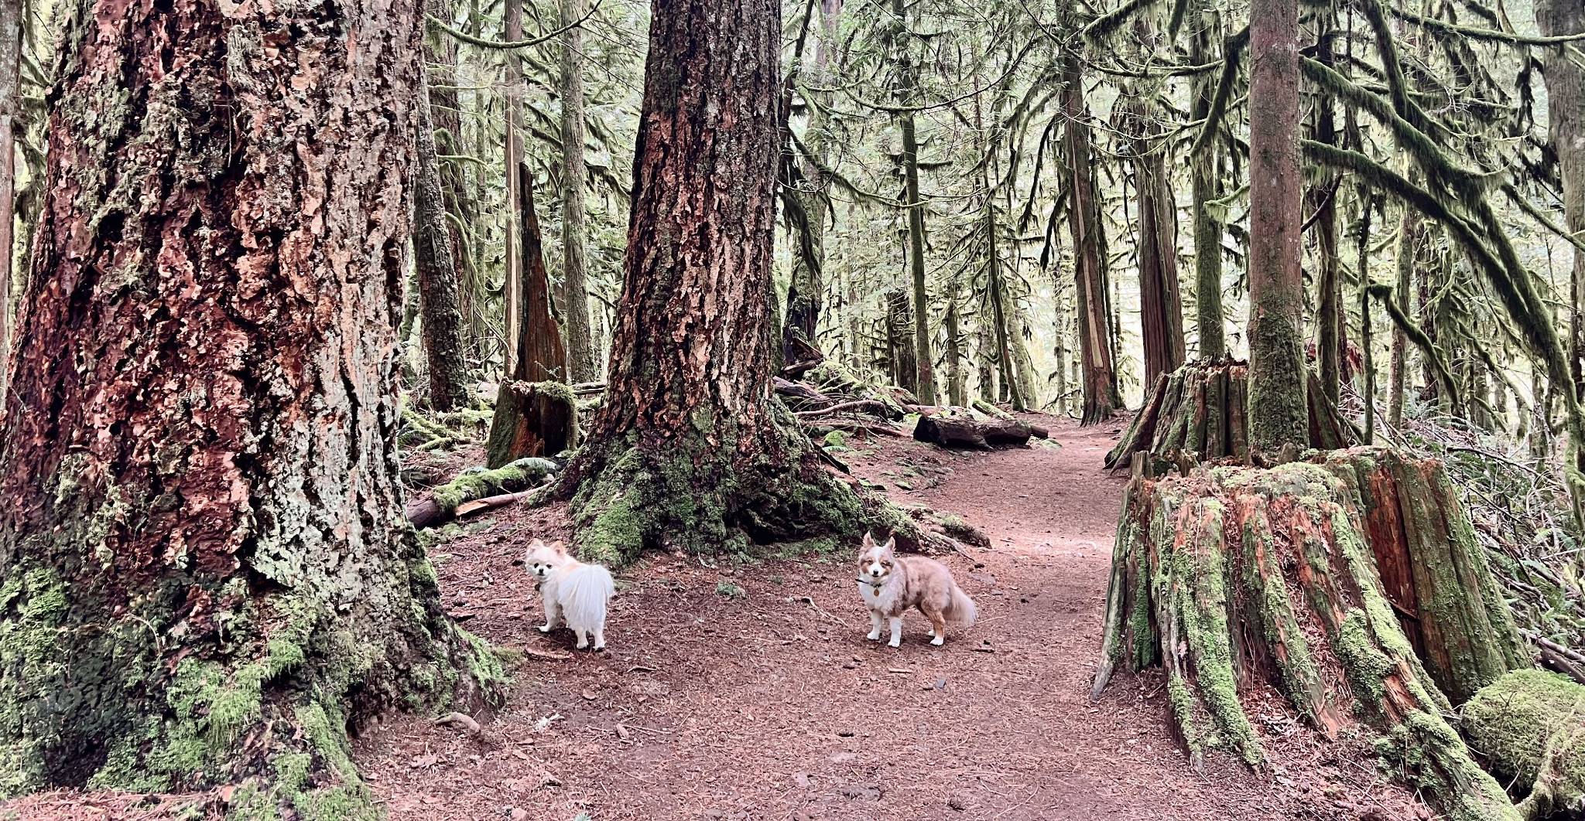
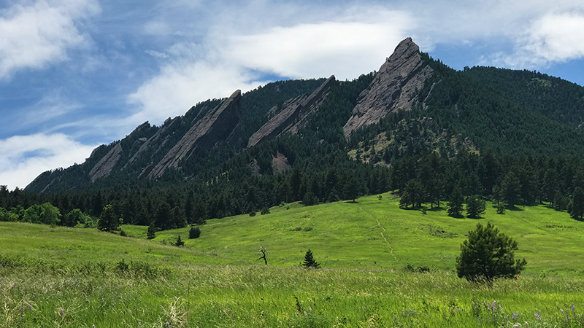
Dog Friendly Trails In Boulder, Colorado
Denisa Iordache
Diana Gibson
Lance Cannon

Slide 2
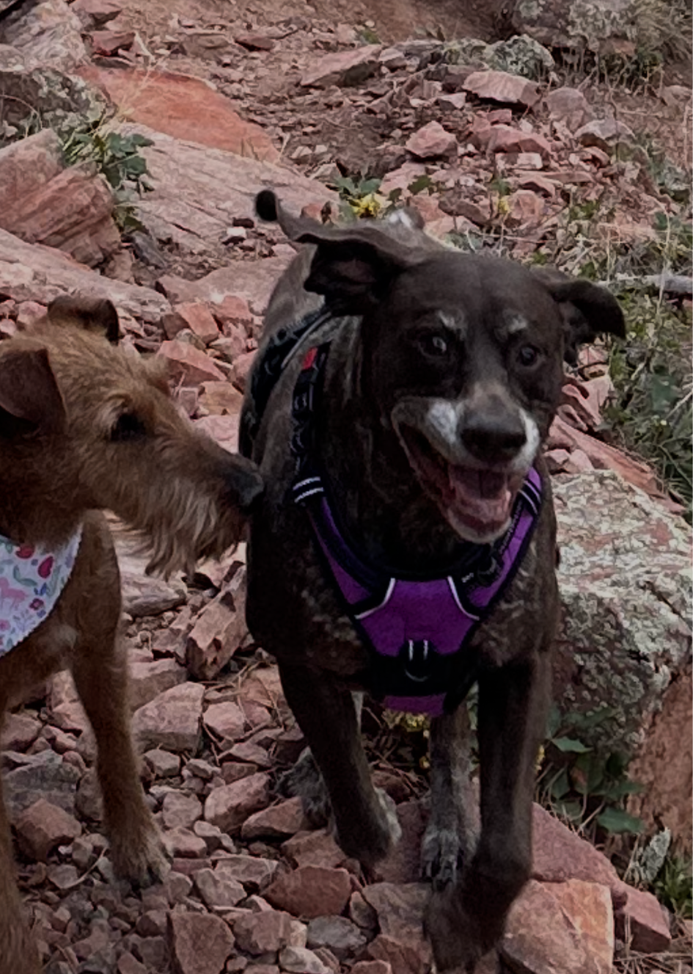
Overview
This project aims to develop an interactive web application that helps outdoor enthusiasts discover dog-friendly hiking trails in Boulder, CO. Using data from the Open Data (https://open-data.bouldercolorado.gov/) and Open Street Map. The platform will provide dog accessibility insights, maps, and trail comparisons—empowering dog owners to make informed choices about where to hike with their pets.

Slide 3
The Process
Boulder Dog Friendly Hiking Trails
Built an interactive web app using trail data, visualizations, Flask, and custom branding.
Data Collection + Preparation
Data Analysis
Visualization
Web App Development
User Experience
Jupyter Notebook
Flask App
Interactivity
Open Street Map Scrape
OSMP Trail Data + GeoJSON
Plotly

Slide 4

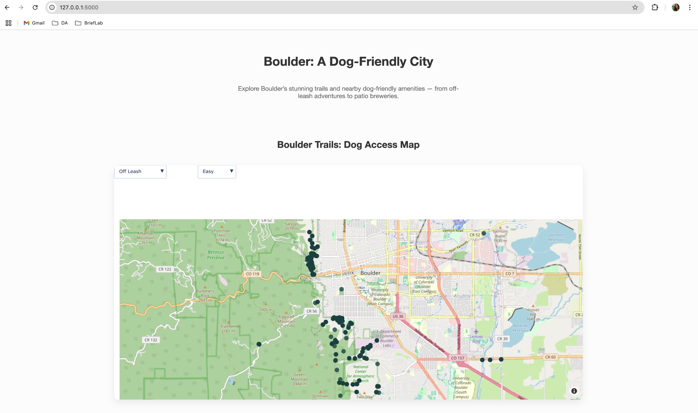
Flask App
http://127.0.0.1:5000

Slide 5
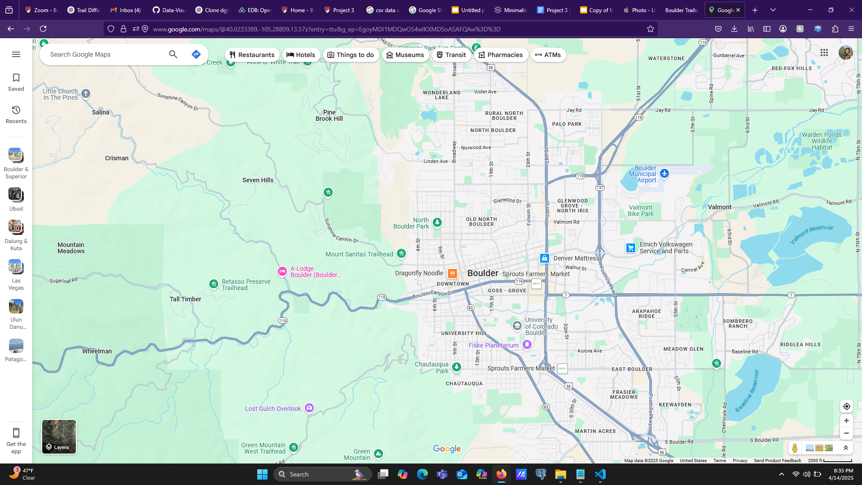
Boulder, CO
A baseline view of Boulder, Colorado, before the addition of any trail data. It serves as a reference point to highlight the city’s geography and key landmarks, offering a clear visual of the area where dog-friendly trails will later be overlaid.

Slide 6
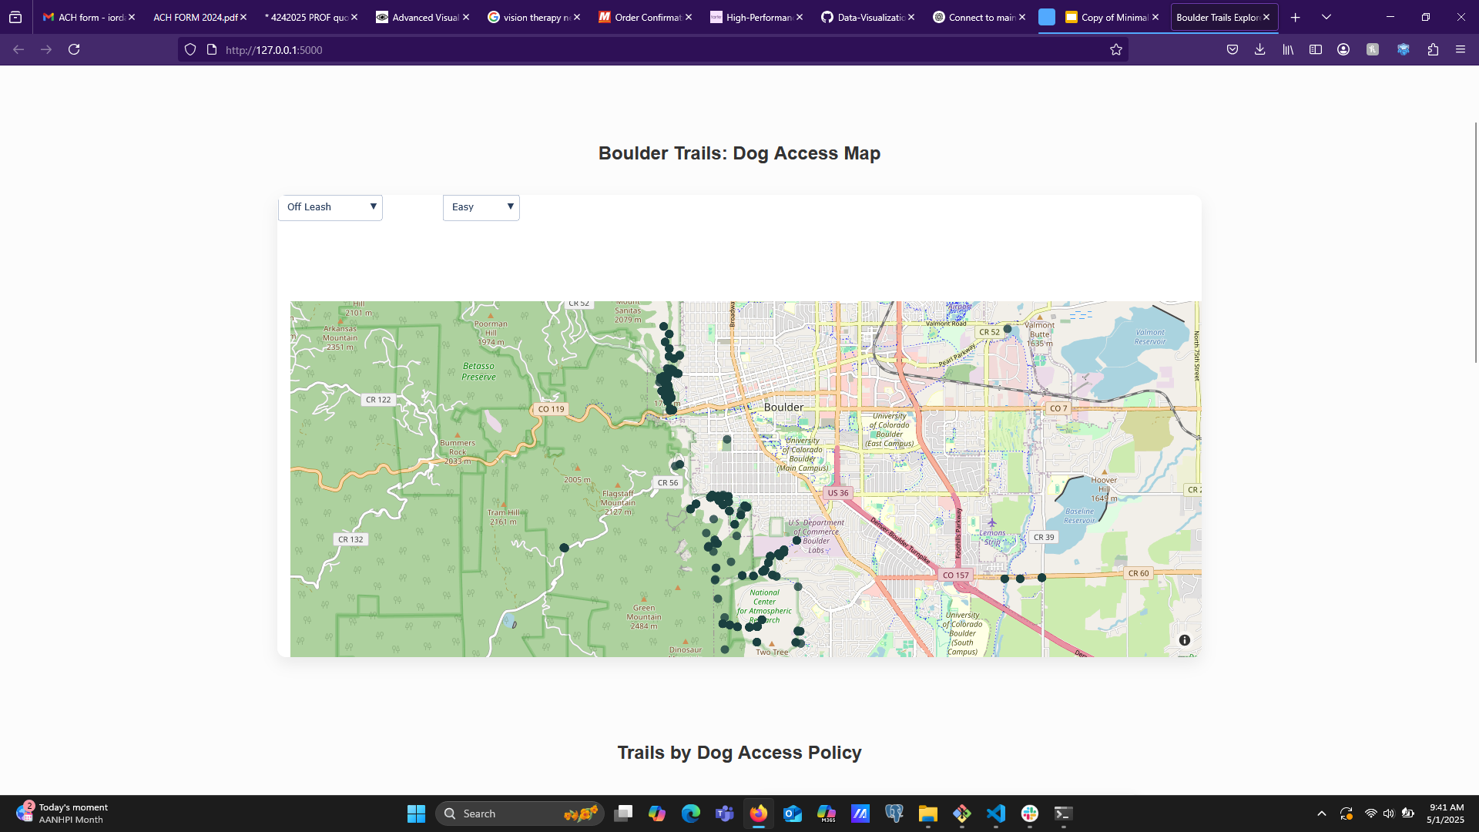
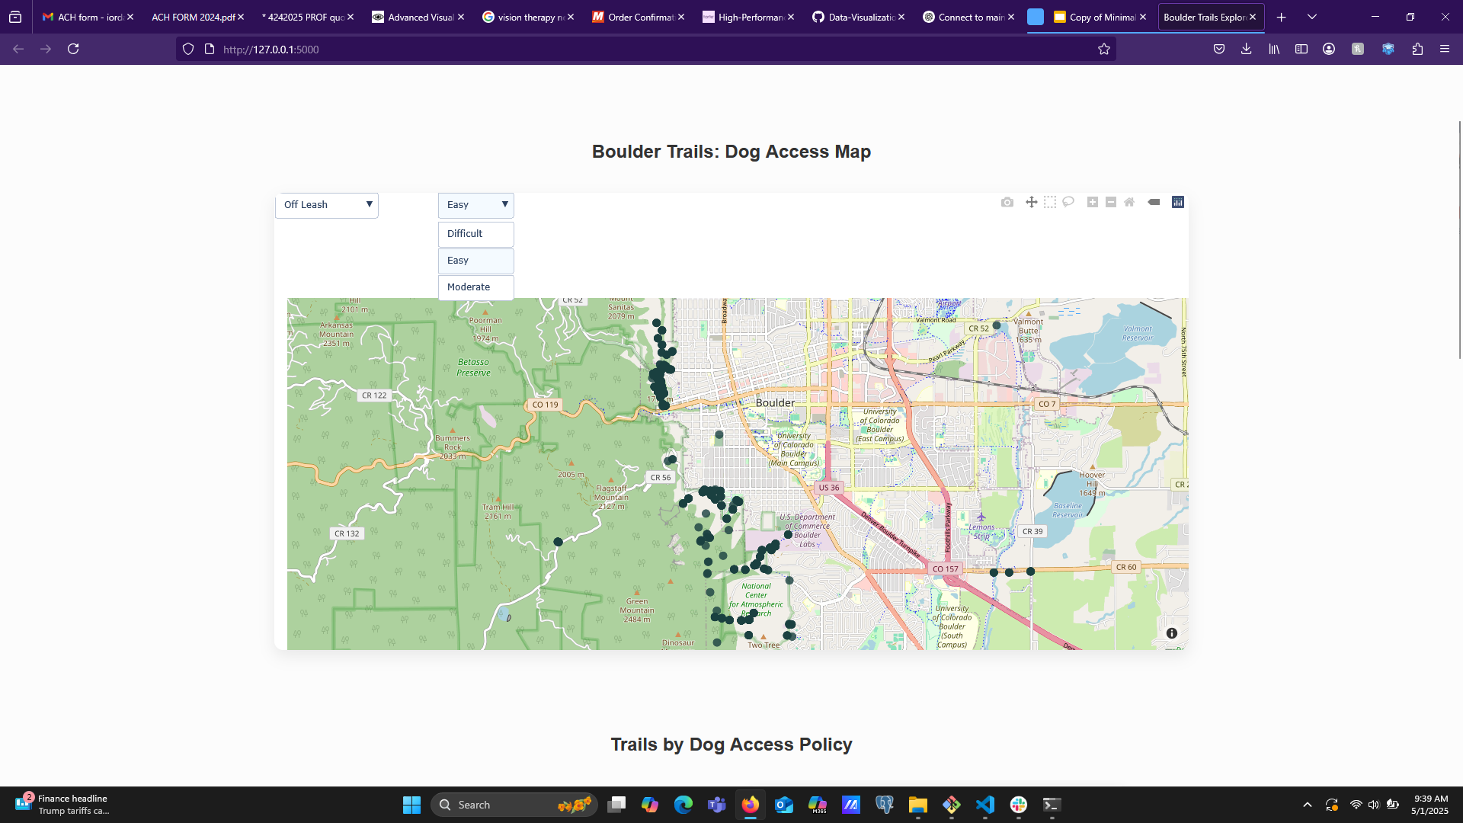
Off-Leash Trails
Visualization highlighting designated off-leash trails within the Boulder area, as part of a broader analysis of dog accessibility on local trails. Each green marker represents a location where dogs are allowed to roam off-leash, helping dog owners identify suitable spots for more flexible outdoor hiking. This is one layer in our interactive map tool, offering user-driven filtering to explore different types of dog access throughout the region.

Slide 7
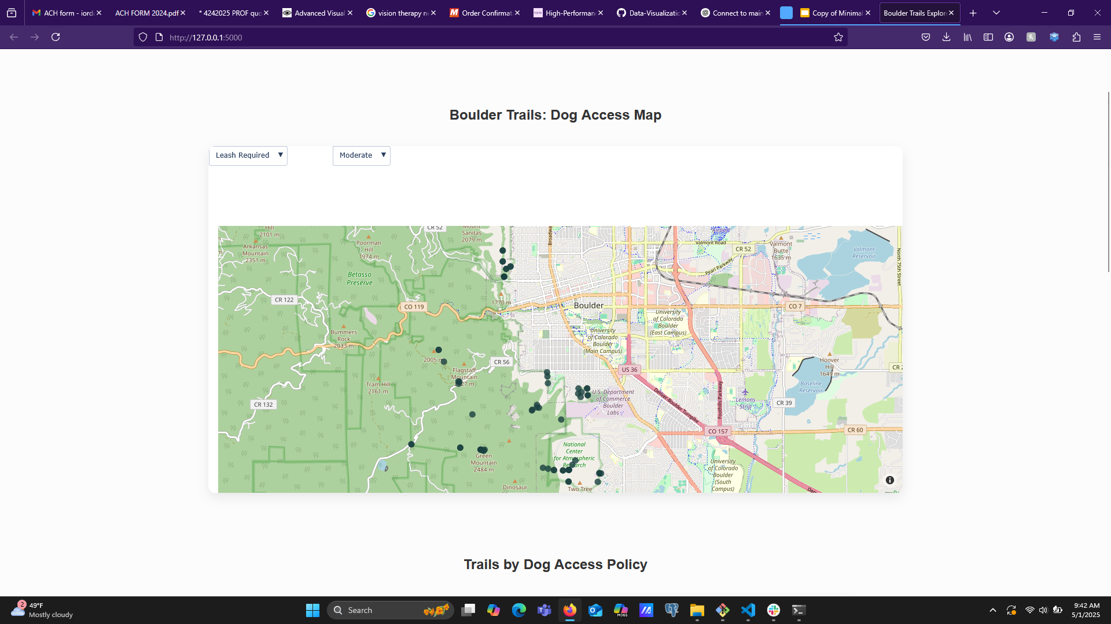

Leash Required Trails
Visualization highlighting areas across Boulder where dogs are only permitted on trails while leashed. Represented by orange markers, these points identify trails that enforce leash regulations to ensure safety for all users—hikers, bikers, and other pets alike. This layer adds another dimension to our dog-access map tool, allowing for an informed and responsible trail experience for dog owners.

Slide 8
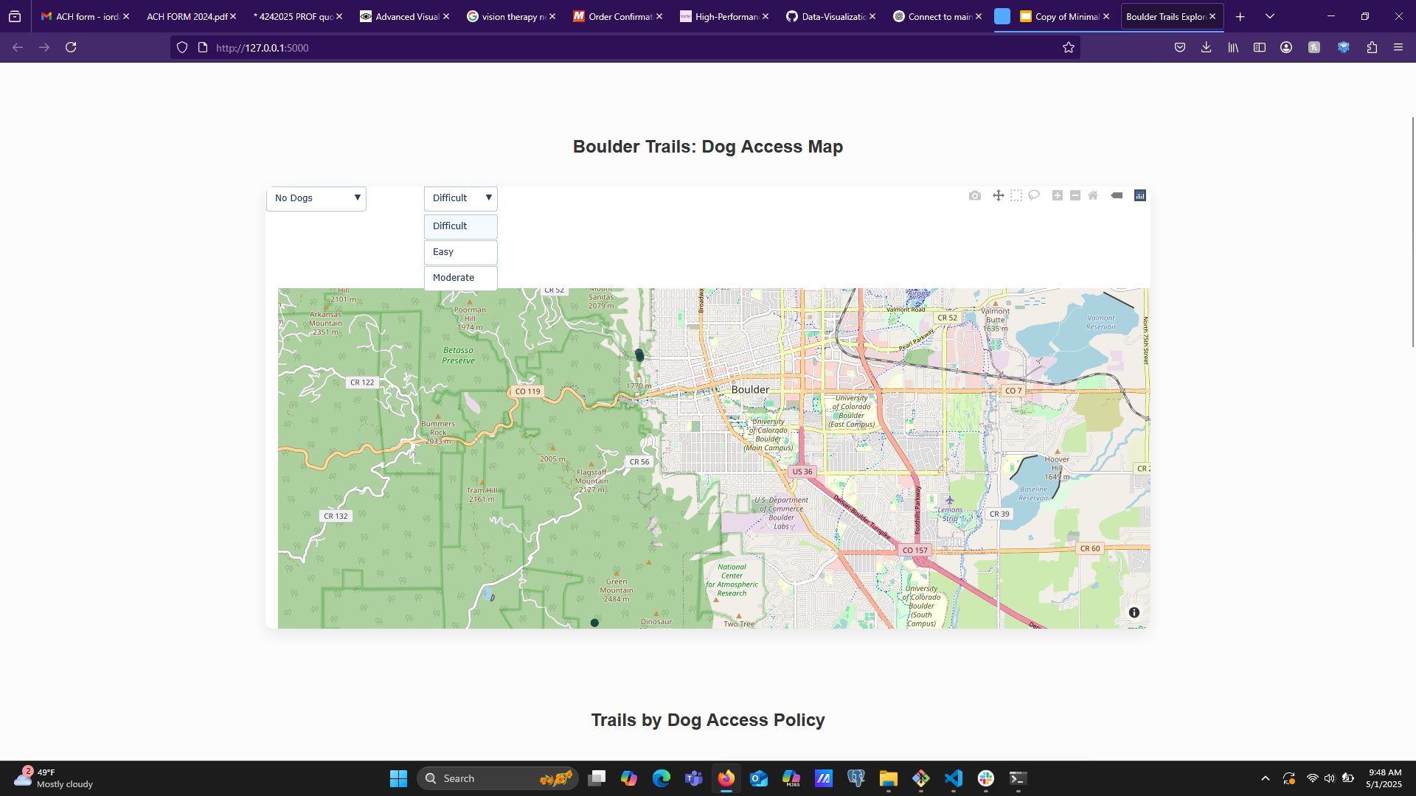

No Dog Trails
Visualization highlighting trails in the Boulder area where dogs are strictly prohibited. Marked with red indicators, these locations represent areas that prioritize wildlife conservation, habitat protection, or high foot traffic where dog presence is restricted. Including this layer in the interactive map helps users avoid these zones and plan their outings accordingly, promoting respectful use of shared outdoor spaces for both people and nature.

Slide 9
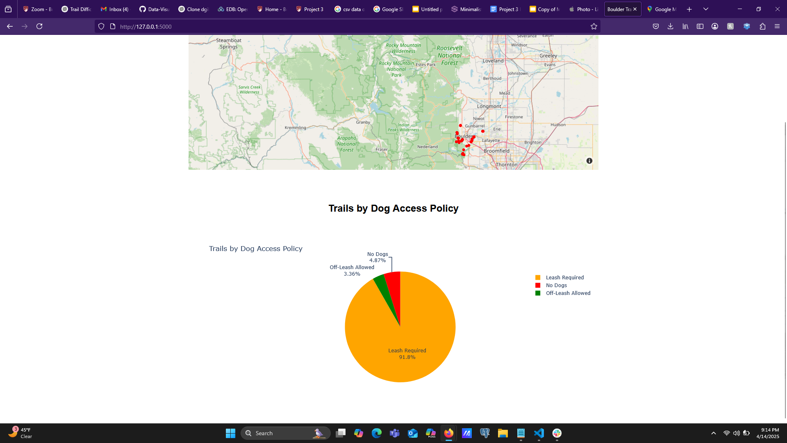
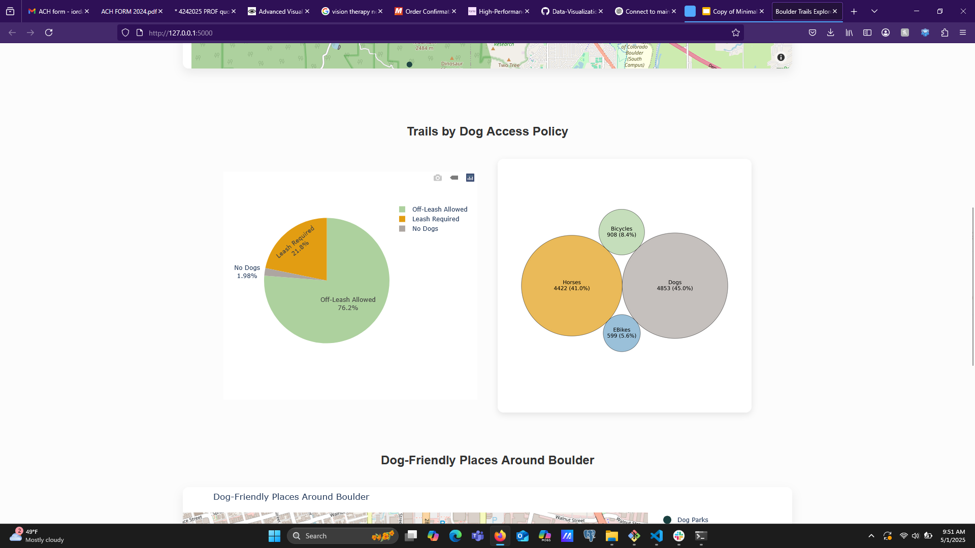

This chart illustrates the breakdown of dog access policies on Boulder’s trails. A majority—over 76%—allow off-leash access, reflecting Boulder’s dog-friendly environment. However, about a quarter of the trails require leashes, and a small percentage do not allow dogs at all. This highlights the importance of respecting trail regulations while also showing the abundance of opportunities for off-leash recreation in the area.

Slide 10

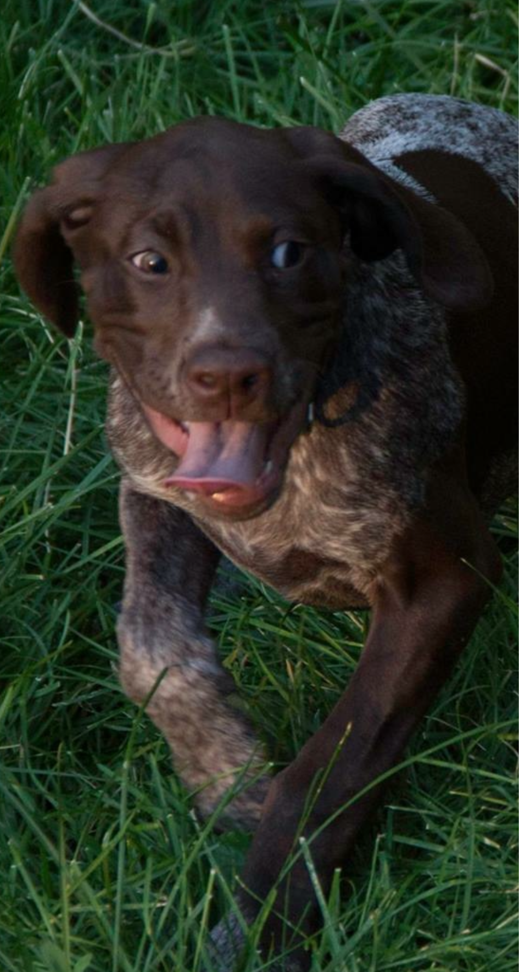
Line graph illustrating the distribution of trail mileage across various hiking paths. Most trails are relatively short, with a significant spike occurring below 0.1 miles—likely due to the inclusion of very short urban or connector trails. As mileage increases, the number of trails steadily declines, with few trails extending beyond 1 mile. This pattern highlights the dominance of short-distance trails in the dataset.

Slide 11
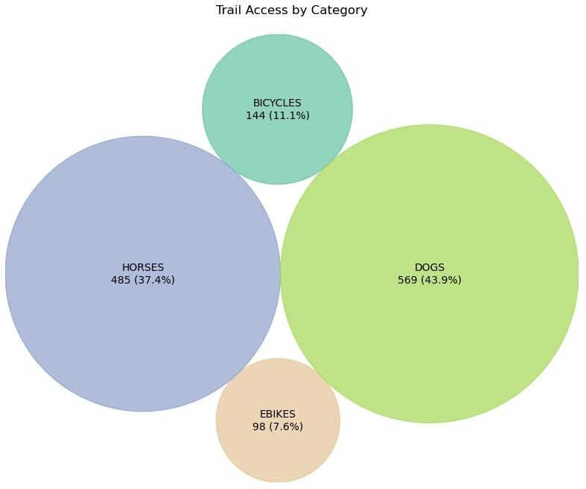
Bubble chart visualizing the distribution of trails based on access for different user groups. Dogs are allowed on the largest number of trails (43.9%), followed closely by horses (37.4%). Bicycle access is available on 11.1% of trails, while e-bikes are permitted on the fewest, with just 7.6%. The size of each bubble corresponds to the number of trails in each category, highlighting that dog- and horse-friendly trails dominate trail accessibility.

Slide 12
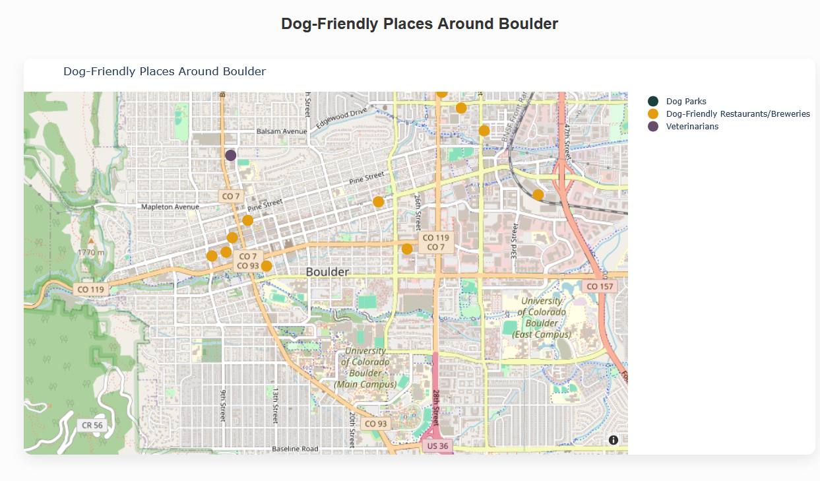
This map showcases dog-friendly locations around Boulder, including parks, pet-welcoming restaurants and breweries, and veterinary clinics. By visualizing these key amenities, it offers a practical guide for dog owners planning outings that combine recreation, dining, and pet care within the city.

Slide 13
Conclusions
Off-Leash Access Dominates Dog-Friendly Trails Over 76% of trails in Boulder allow dogs off-leash, emphasizing the city’s support for dog-friendly recreation. However, nearly a quarter of trails still require leashes, and a small percentage prohibit dogs entirely. This underscores the importance of understanding access rules before hitting the trail.
Trail Network Is Highly Fragmented and Dense Most trails are under 0.5 miles long, with a large portion less than 0.1 miles. This pattern reflects a dense network of short, urban connector trails that enhance accessibility but offer limited options for extended hikes.
Dogs and Horses Are the Primary Trail Users Dogs (43.9%) and horses (37.4%) have the highest trail access, highlighting a focus on recreational use for pet owners and equestrians. In contrast, access for bicycles (11.1%) and e-bikes (7.6%) is significantly lower, showing limited prioritization for wheeled users.
Regulations Emphasize Responsible Use While off-leash trails are abundant, the presence of leash-required and no-dog zones indicates strong trail regulations aimed at safety, conservation, and shared use. This makes accessible and accurate trail data essential for responsible planning by dog owners.

